Slide 1
Lecture 9
Classes and structures, pt.1
Konstantin Leladze
OOP in C++
DIHT MIPT 2021

Slide 2
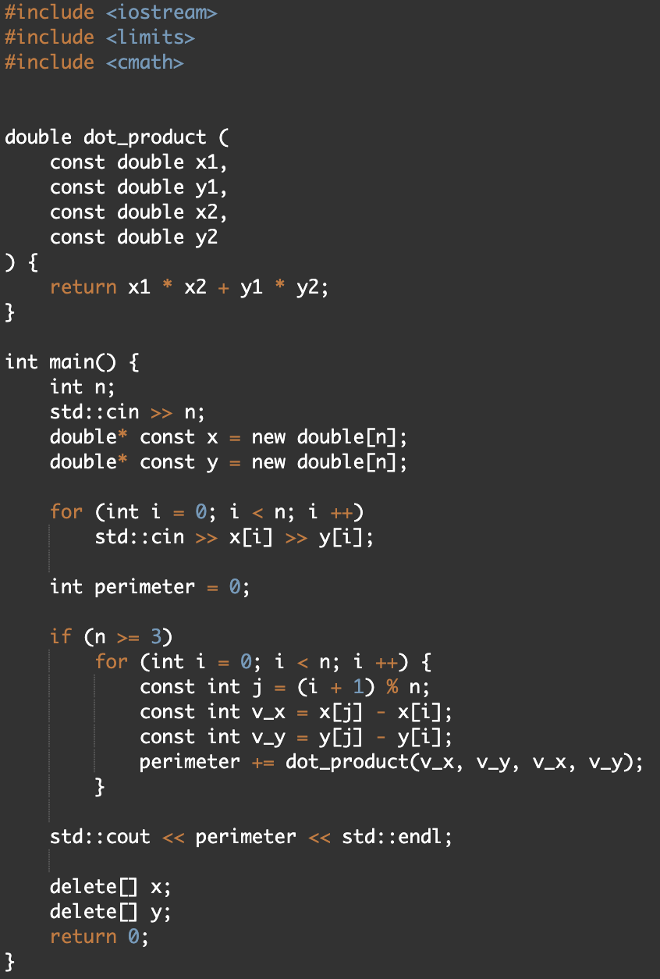
Structures, motivation
Let’s have a look on the solution of the problem about perimeter of convex polygon, which we have discussed in the previous lesson.
Problem:
We have to use two different arrays for storing x and y coordinate.
If we formulate this problem in such a way that it needs to be solved in 3D, then the number of arrays will increase to 3.
Maybe there is a tool thanks to which we could declare our own user-defined type and store these three variables of type double inside one single type?

Slide 3
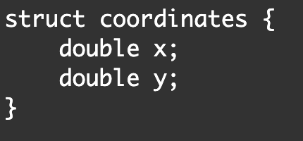
Structures, definition
The struct keyword allows us to define our own custom type, which can (and in our case will) contain variables.
The code shown in the screenshot on the right only defines the coordinates type, but does not create a variable of its type.
In-class declared variable is called a member field.
For example, in this struct we have 2 member fields: x and y.

Slide 4
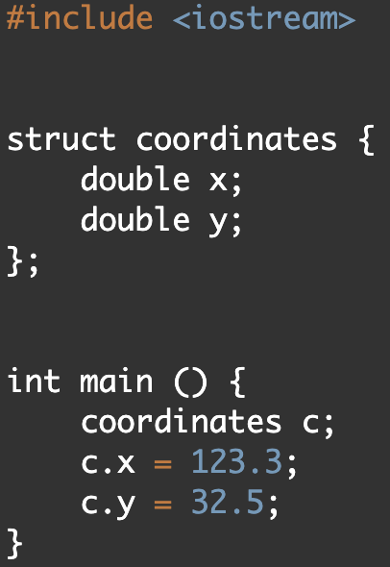
Instance VS Definition
To create a variable of our own specified type coordinates, we need to write the following code (see int main). Now, variable c is called instance of structure coordinates.
The number of instances of the coordinates structure is not limited. You can imagine a struct is a blueprint and its instances are products made from this blueprint.
The variables x and y are contained within the coordinates type. To access them (both read and write), you need to use a special operator . (will be discussed in the future).
Their lifetime is limited by the lifetime of an instance of structure coordinates: when it is destroyed, so are the variables it contains.

Slide 5
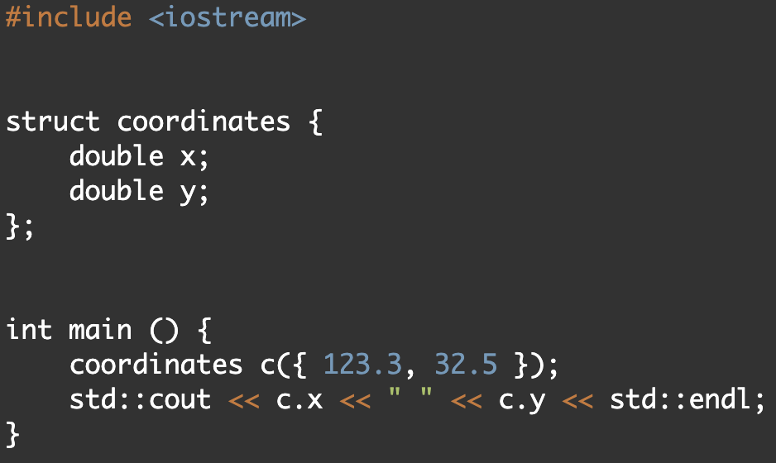
Constructor
Let's imagine that we have created a structure containing 10 internal types. Agree, writing 10 lines of code to initialize each variable inside is not the most pleasant job.
There is such a thing as a constructor. The constructor allows you to initialize all variables inside the structure instance with values. On the right, I gave an example of the direct-list-initialization constructor.

Slide 6
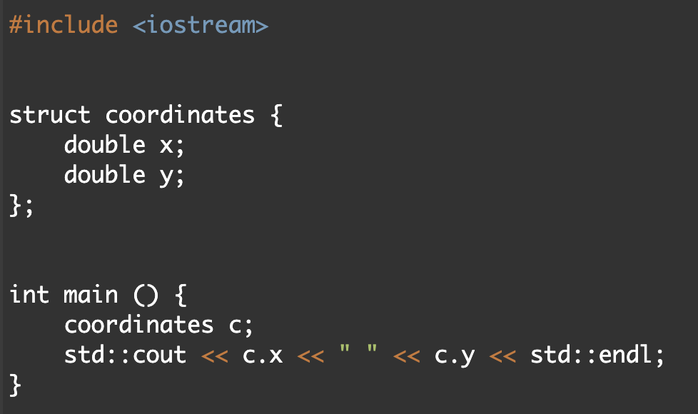
Default Constructor
In most cases (in which specifically we will discuss later), the structure has a default constructor which does not accept any arguments and initializes all fields by default.
For example, in the case of our structure, the default constructor will fill x and y with zeros (and not random values, how would it happen if we set these variables in the main function)

Slide 7
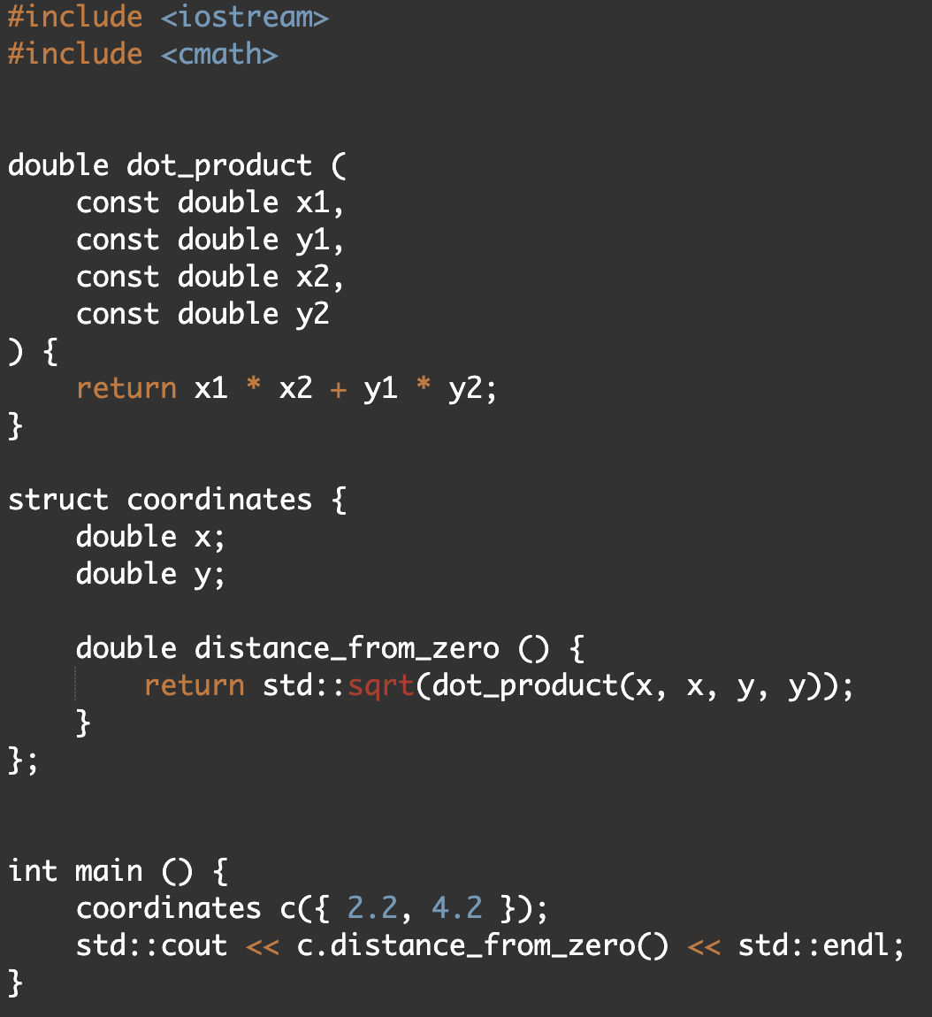
Methods
In addition to variables, we can define functions inside structures. A function defined inside structures is called a method.
In this case, all the variables contained in the instance of the structure will be available in the body of the function.
To call a method, we need to apply an operator . to some instance

Slide 8
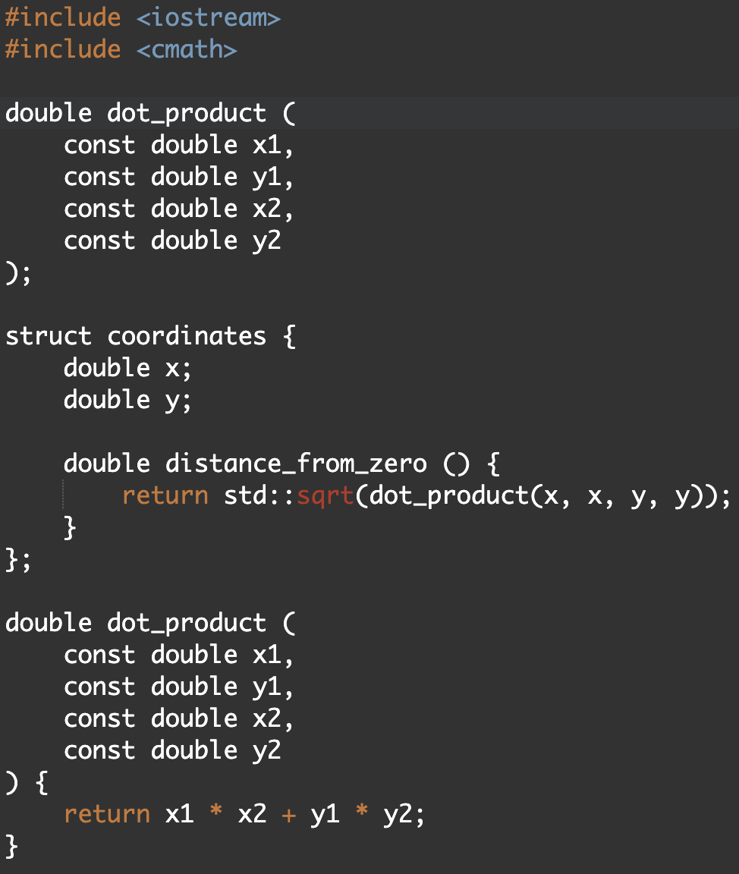
Static methods, motivation
In the previous example, we defined the dot_product function outside of the class. This is not very convenient, because in this case we need to keep in mind the fact that the coordinates struct is associated with the dot_product function. For example, if we want to transfer the definition of the class coordinates, we will need to transfer the definition of the dot_product function (or make a forward declaration)

Slide 9
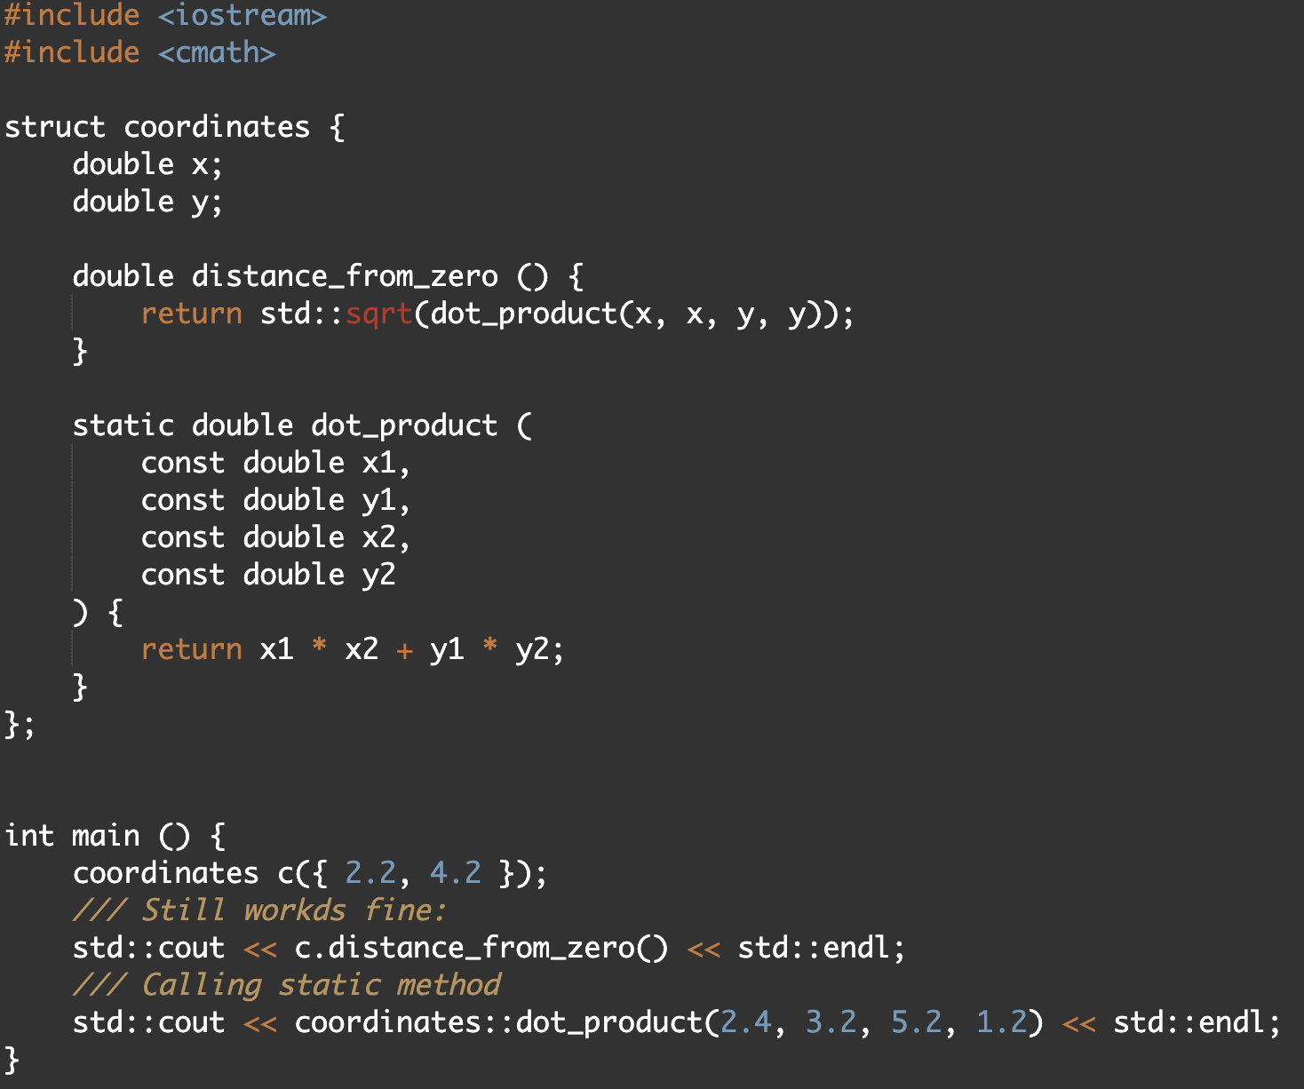
Static methods
To solve this problem, we can use a static method. The Static method is not associated with a specific instance of the structure, but with its type.
Because of this, inside a static method, we cannot access the variables defined inside the class, which, by the way, are called "fields".
You can call a static method from within a class simply by specifying its name.
To call it from outside, you need to apply the operator :: to the type of the struct (not to its instance!)

Slide 10
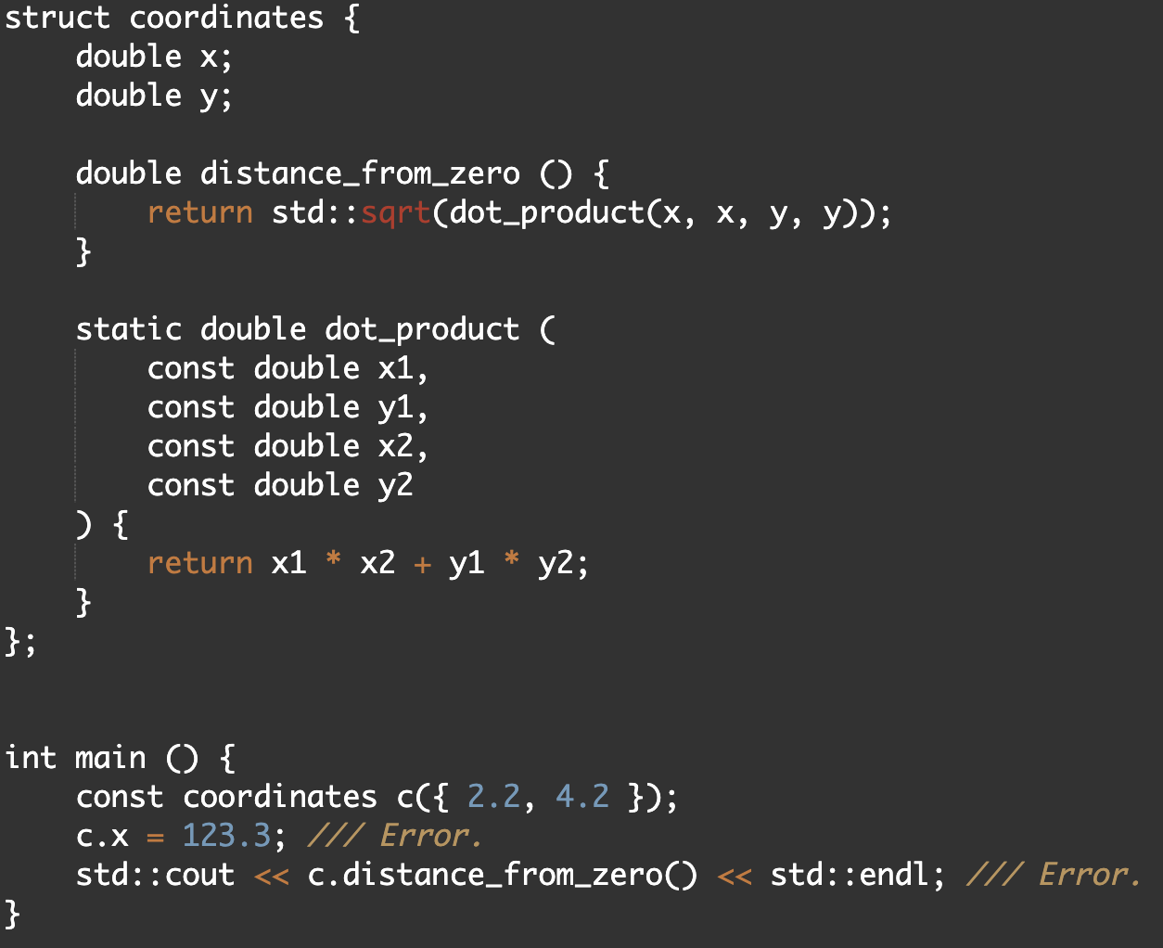
Const qualified instance
Struct instances can be const-qualified. In this case, we will not be able to change the internal variables of these structures and call non-const methods.
But what exactly is a non-const method? Non-const method is a method that is not defined as const!

Slide 11
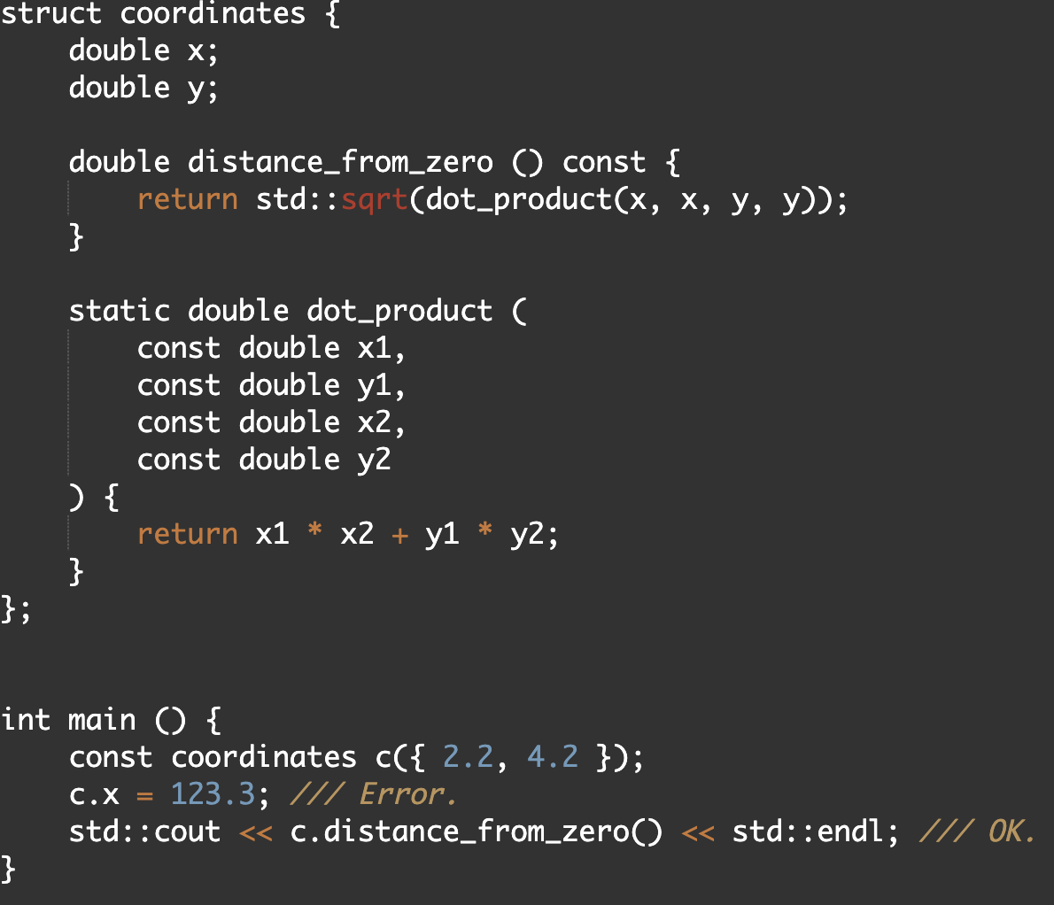
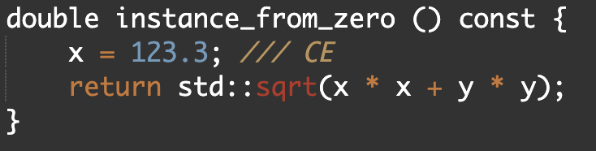
Const Methods
A const method is a method that can be called on a const-qualified instance, but it can NOT modify the internal fields of a structure:

Slide 12
Structures in std
C ++ cannot be imagined without the ability to define your own custom types. In fact, the language itself already has many built-in structure types.
For example:
std::vector
std::cin
std::cout
std::array
std::string
std::allocator
and many, many more…
In fact, most of these types are defined using the class keyword. To understand what its meaning is, let's look at such a thing as encapsulation.

Slide 13
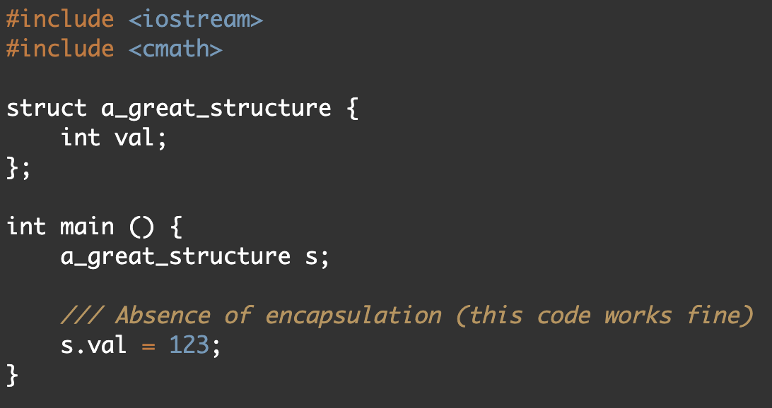
Encapsulation
In object-oriented programming (OOP), encapsulation refers to the bundling of data with the methods that operate on that data, or the restricting of direct access to some of an object's components.
Encapsulation is used to hide the values or state of a structured data object inside a class, preventing direct access to them by clients in a way that could expose hidden implementation details or violate state invariance maintained by the methods.

Slide 14
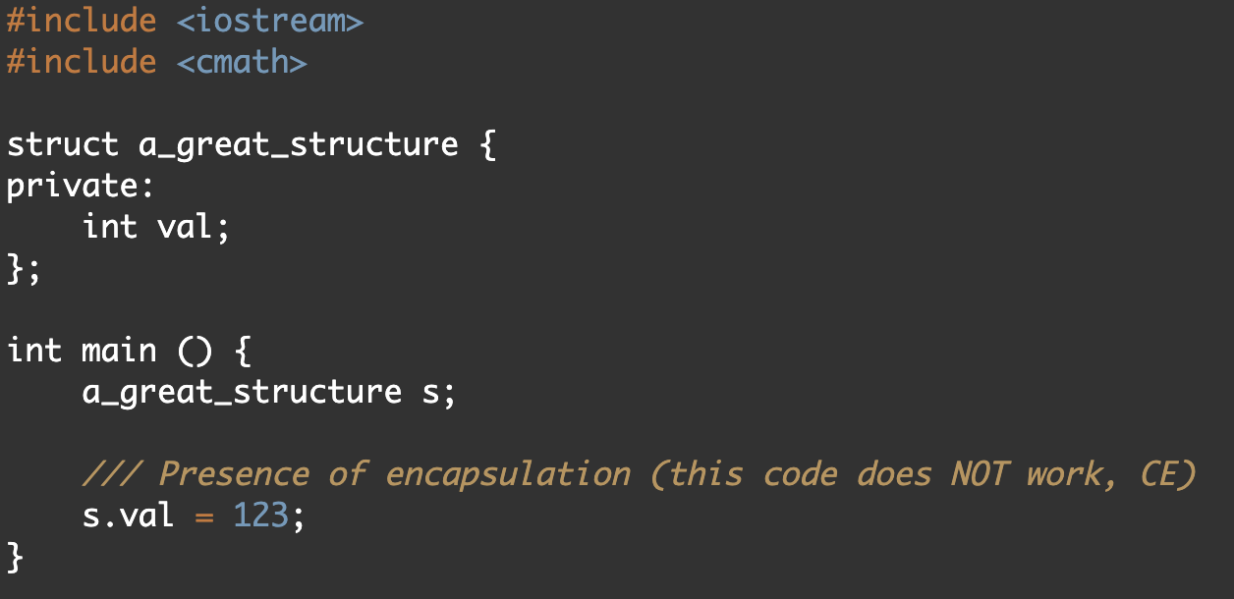
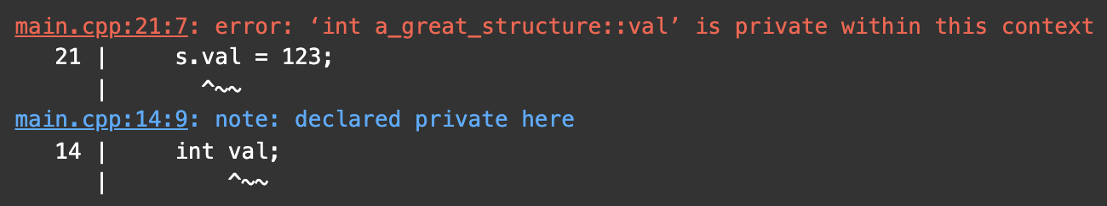
Private and public keywords
The special word private allows us to hide the fields of the structure from an external user, prohibit access to them.
The public keyword is the opposite of private. By default, all fields of the structure are set to public.

Slide 15
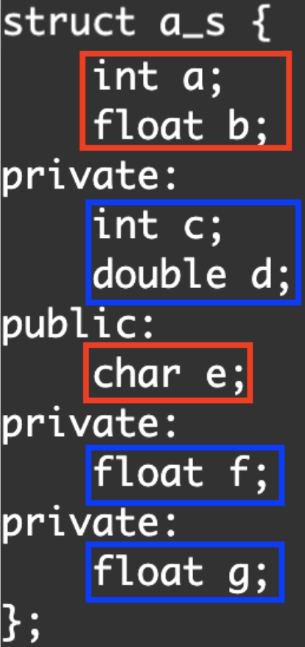
Sections
When we use a private or public keyword, we create the corresponding section in the class or struct.
All fields and methods specified after the beginning of a section (after specifying the word private or public), but before the beginning of the next section, refer to it.
In the screenshot, private variables are boxed in blue, public - in red.

Slide 16
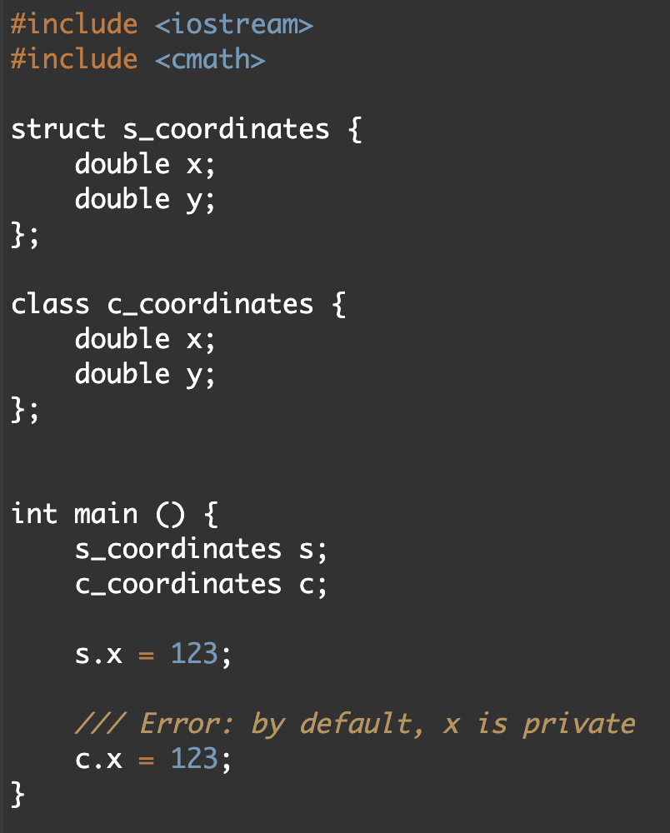
struct vs class
There are 2 differences in total between class and struct. These differences are:
1)
By default, section of struct is public
By default, section of class is private
2) We will discuss the second difference later.
Since there is little difference between class and structure, you can use both words. However, it is common practice to use the word struct only when you are not specifying private fields (not using encapsulation). If your type uses encapsulation, it is better to define it as a class.

Slide 17
Lecture 9
Classes and structures, pt.1
Konstantin Leladze
OOP in C++
DIHT MIPT 2021

